Slide 1

Estimation of Zn²⁺ & Pb²⁺ ions
in a given solution complexometrically
Rohan Singh, Nutan Sharma
Department of Chemistry
University of Delhi

Slide 2
Chemicals Required
Complexone: EDTA solution
Standard: ZnO as primary standard
Indicators: Eriochrome Black-T (EBT) and Xylenol Orange (XO)
Buffers: NH₄OH-NH₄Cl solution and Hexamine
Auxiliaries: Ammonium acetate and acetic acid
1

Slide 3
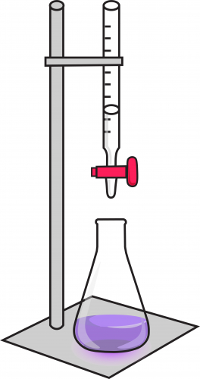
Complexometric Titrations
Complexometric titrations are a form of volumetric analysis in which the formation of a colored complex is used to indicate the end point of a titration
These are used mainly to determine metal ions in a mixture by use of complex-forming reactions
Most common chelating agent used for in these titrations is EDTA
2

Slide 4
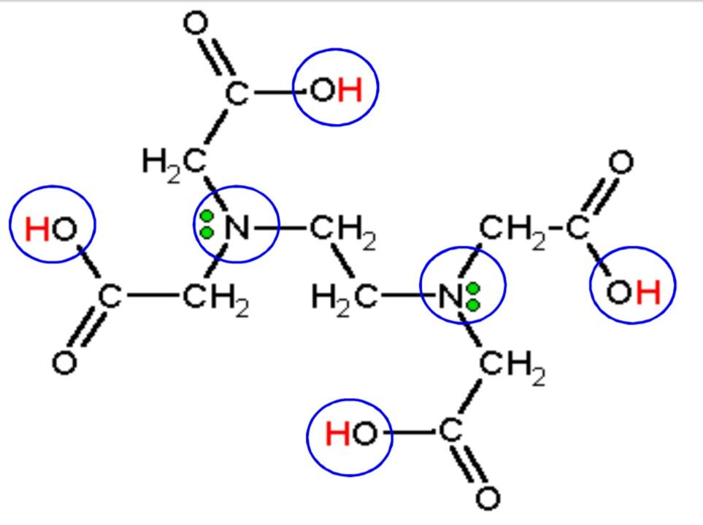
Why EDTA??
Reasons for using EDTA
Forms strong 1 : 1 complexes with most metal ions
Large formation constants with many metal ions
Forms stable, water-soluble metal complexes
Titrations with EDTA gets affected by pH factor, stability constant of the complex formed etc.
pH is important to guarantee the selectivity and accuracy of the analysis
The more stable the chelate, the lower the pH at which the titration can be performed.
6 metal binding sites making it hexadentate ligand
3

Slide 5
Estimation of Zn²⁺ & Pb²⁺
Zn²⁺ and Pb²⁺ when present simultaneously in a solution can be estimated using direct titration with EBT and Xylenol Orange indicator in different pH ranges
Different pH range is preferred for increasing selectivity
Before proceeding to titration, Zn²⁺ and Pb²⁺ ions must be separated using a suitable precipitating agent.
Another technique that might also be used is masking which eliminates the need for separating both the ions
Cyanide ion can be used as masking agent in this method.
IN A MIXTURE
4

Slide 6
Need for separation of Zn²⁺ and Pb²⁺
Formation constant of metal-EDTA complex:
K_{f} = [M-EDTA]
[M][EDTA]
A metal, M can be very easily titrated in presence of other metal, N if the formation constant values of these ions is such that:
K_{M}/K_{N} >= 10⁸ (in presence of complex forming indicator )
But making K_{f}(Pb)/K_{f}(Zn) = 10^{1.5}
Because of this proximity of formation constant values of these two complexes, Zn²⁺ and Pb²⁺ must be separated before proceeding to titration. (formation of both Zn-EDTA and Pb-EDTA complexes in the same solution makes it difficult to estimate their concentrations individually)
K_{f} (Zn-EDTA complex) = 10^{16.5}
K_{f} (Pb-EDTA complex)= 10^{18.0}
5

Slide 7
Separation of Pb⁺²
Precipitating agent is chosen in such a way that it forms a precipitate with only one of the metal ion leaving out the other in the solution form
Precipitating agent: K₂SO₄ solution. In case K₂SO₄ is unavailable, K₂SO₃ or Na₂SO₃ can be used after
oxidation with HNO₃
Conditions for precipitation:
ionic product > solubility product (K_{sp})
Size Compatibility between cation and anion
lattice energy > hydration energy
Pb²⁺ + SO₄²⁻ ➔ PbSO₄ : much more stable, white ppt is obtained
Water's dipole strength is too weak to pull away the ions (both anions and cations) from the strong crystals of lead sulphate
Solution is warmed to increase rate of precipitation. K₂SO₄ is added dropwise to avoid super saturation
ZnSO₄ if formed, is soluble in water
PbSO₄ satisfies all the 3 criteria
K_{sp}= [Pb²⁺]×[SO₄²⁻] = 2.53 × 10⁻⁸ M²
Size of Pb²⁺ = 119 pm
Solubility = 0.00443 g/100 mL (20 °C)
6

Slide 8
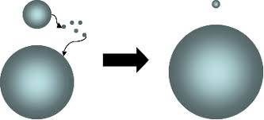
Digestion of precipitate
Occurs when a freshly-formed precipitate is left, usually at a higher temperature, in the solution from which it is precipitated.
Need: Results in bigger particles, generally purer, easier to wash & filter → Ostwald ripening
larger particles → greater volume to surface area ratio → lower energy state (more favored)
Molecules on the surface of a particle → energetically less stable than the ones already well ordered and packed in the interior.
System tries to lower its overall energy → molecules on the surface of a small particle tend to diffuse through solution and add to the surface of larger particle.
Energetic factors → large precipitates grow, drawing material from the smaller precipitates, which shrink
71

Slide 9
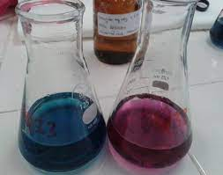
Estimation of Zn²⁺ ions
Zn²⁺ ions in the solution are estimated by titrating the filtrate with EDTA solution using EBT as indicator.
K_{f} ( Zn-EBT) < K_{f} (Zn-EDTA)
pH range = 10 (NH₄OH-NH4Cl buffer is added)
For neutralizing effect of H+ ions released on reaction of Zn²⁺
with EDTA and EBT: Enables the formation of the Zn²⁺ with
EDTA at the appropriate pH
avoid the Zn²⁺ ion precipitation (as Zn(OH)₂) in alkaline pH
Difference in number of ligating centres in EBT and EDTA
Zn2⁺ + EBT (blue) ➔ Zn-EBT (wine red colour) + 2H+ Zn-EBT (wine red) + EDTA ➔ Zn-EDTA + EBT (blue)
8

Slide 10
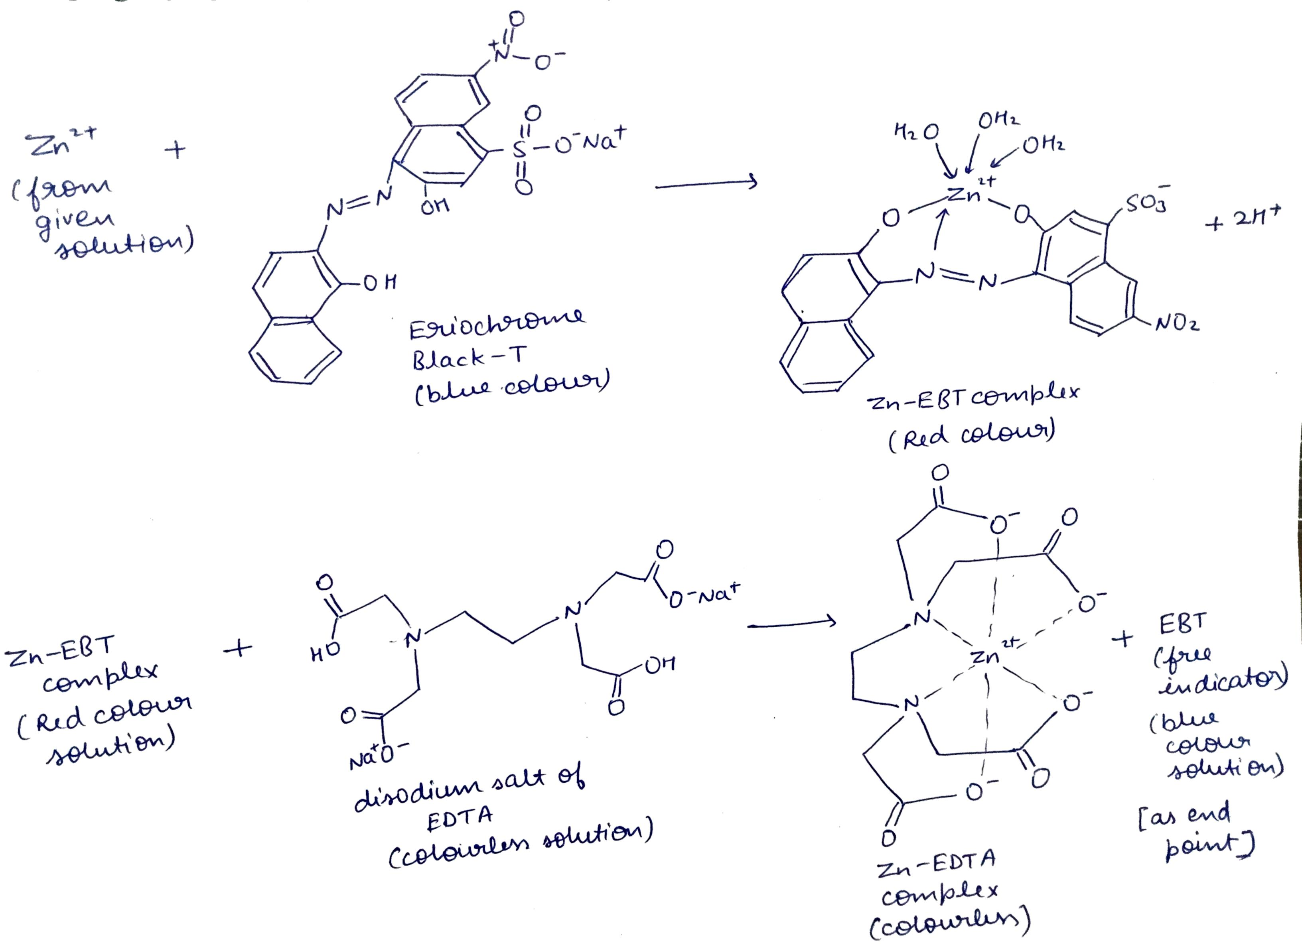
9. Reactions for estimation of Zn²⁺

Slide 11
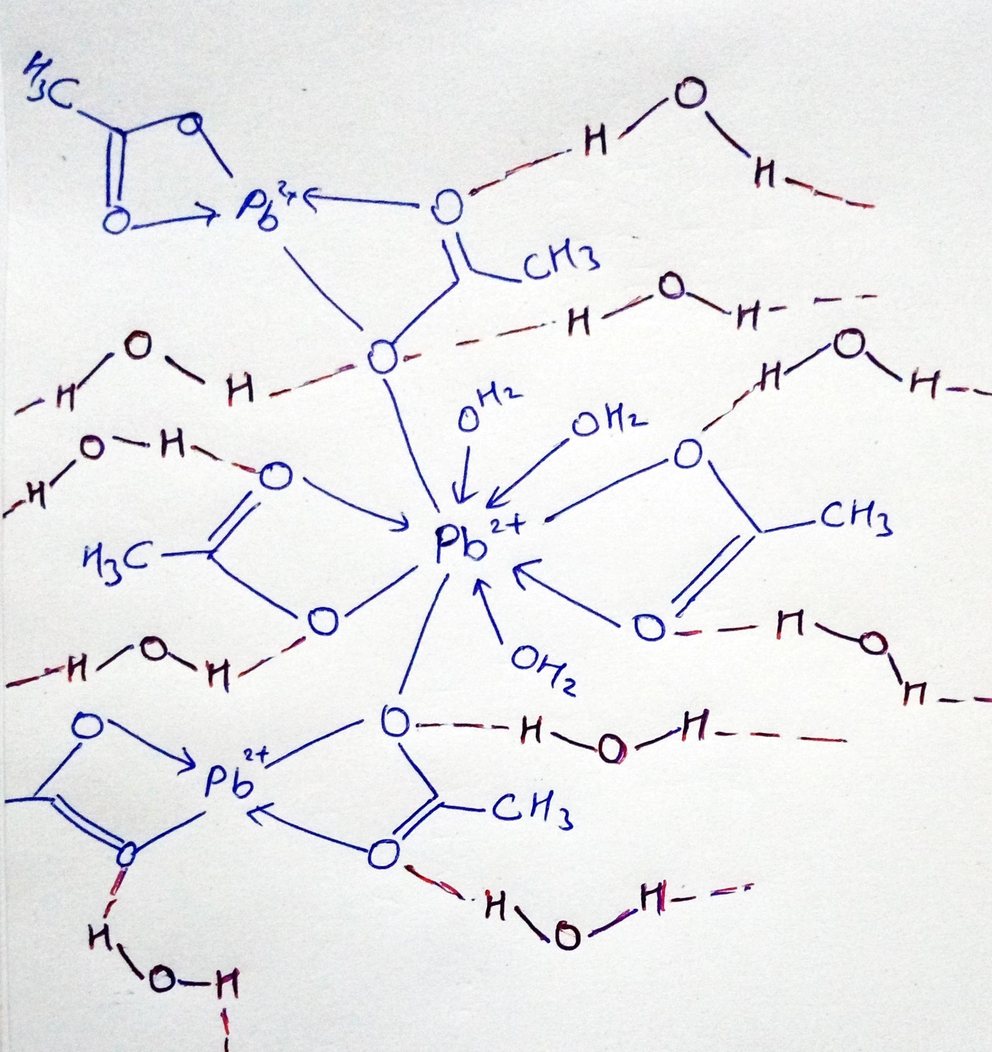
Dissolution of PbSO₄ ppt
Dissolved using ammonium acetate and acetic acid
Why lead acetate is soluble???
It is soluble because of hydrogen bonding present due to its structure. In the trihydrate, the Pb²⁺ ion’s coordination sphere consists of nine oxygen atoms belonging to 3 water molecules, two bidentate acetate groups and two bridging acetate groups.
Uses: keeps Pb²⁺ in solution form preventing its hydrolysis
PbSO₄ + 2CH₃COONH₄ ➔ Pb(CH₃COO)₂ + (NH₄)₂SO₄ (insoluble) (soluble) Pb(CH₃COO)₂ + H₂O ➔ Pb(CH₃COO)₂ .3H₂O (Soluble)
10

Slide 12
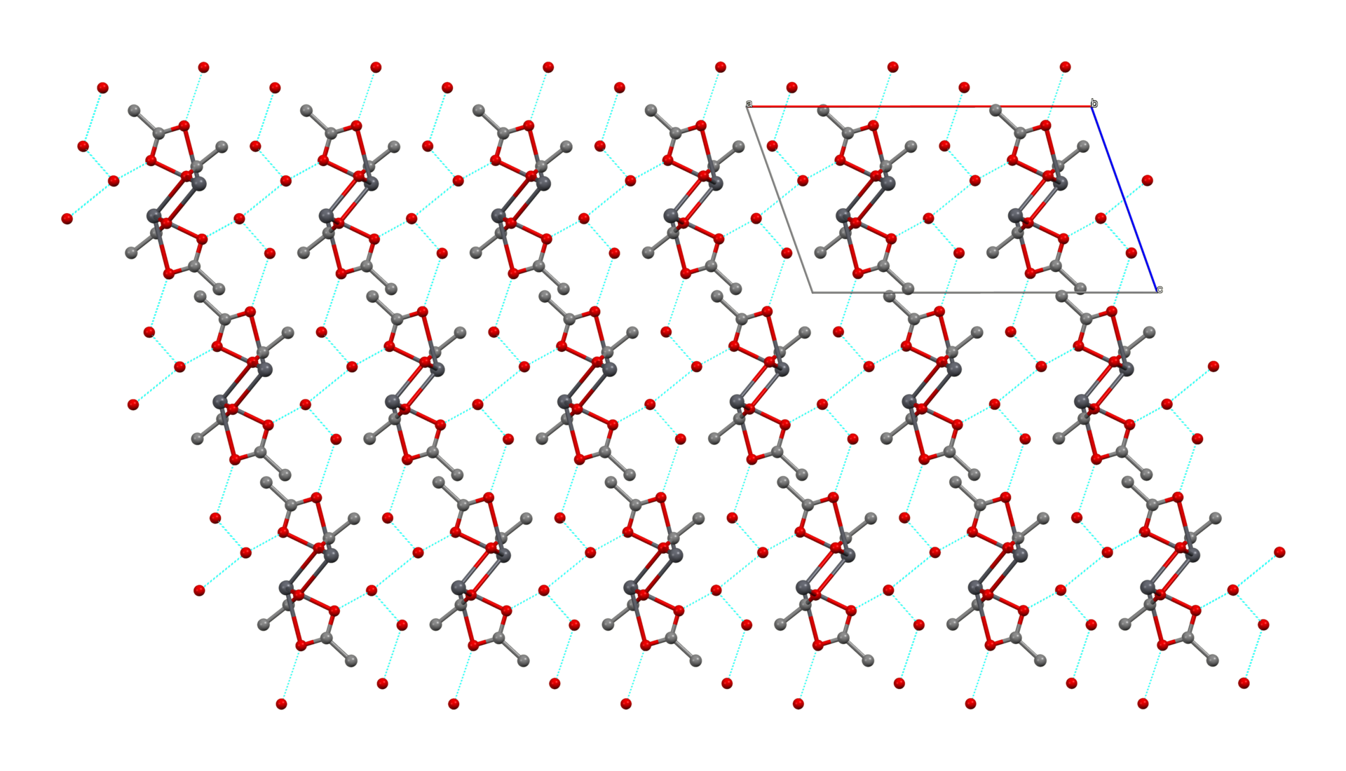
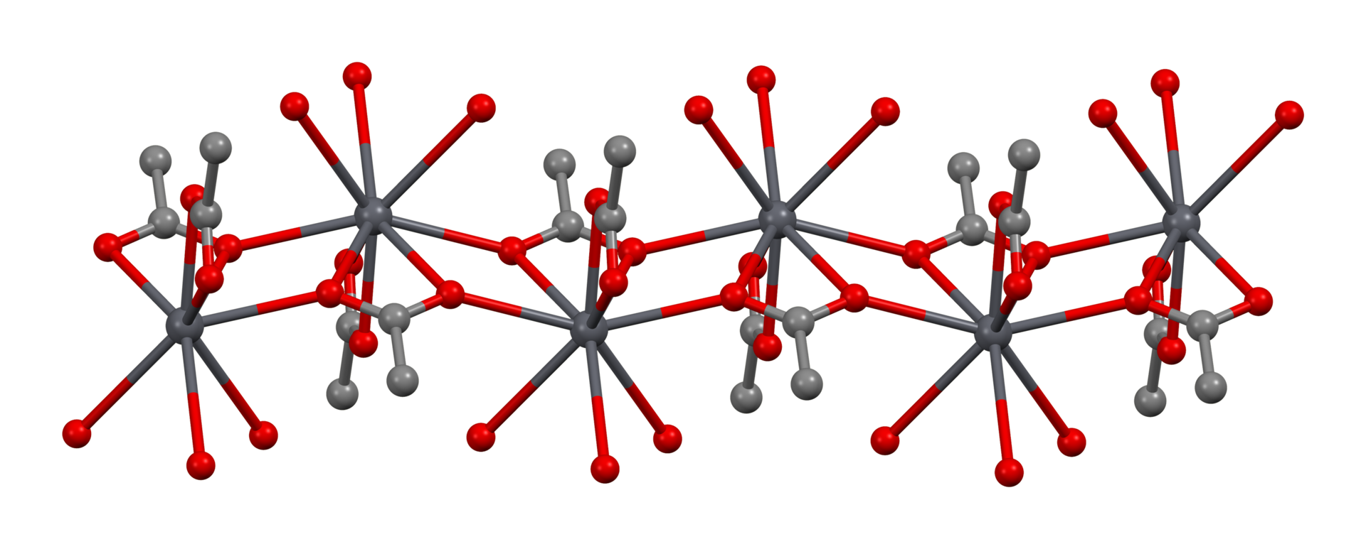
11. Structure of Lead Acetate (trihydrate)
Hydrogen bonding in the crystal structure

Slide 13
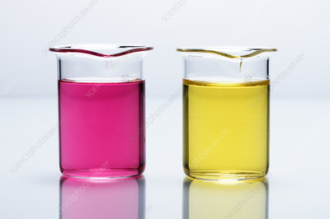
Estimation of Pb²⁺ ions
Pb2⁺ ions in the solution can then be estimated by direct titration with EDTA solution using Xylenol Orange as indicator.
pH maintained is 5 ➔ obtained by adding hexamine buffer solution
Why 5-6 pH??
For maximum stability of Pb-EDTA complex
to increase selectivity of EDTA
To prevent hydrolysis of Pb²⁺ ions
Pb²⁺ + XO (lemon yellow) ➔ Pb-XO (violet red)
Pb-XO (violet red) + EDTA ➔ Pb-EDTA + XO (lemon yellow)
12

Slide 14
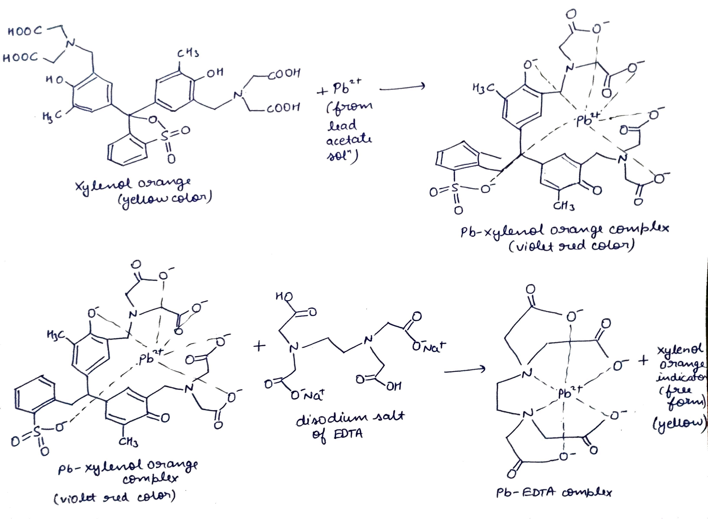
13. Reactions for estimation of Pb²⁺

Slide 15



Procedure
1. Preparation of standard solution of ZnO in 100 mL
ZnO(s) + 2HCl(aq) ➔ ZnCl₂ (aq) + H₂O (l)
2. Standardization of EDTA solution with std ZnO sol: EDTA solution is taken in burette.
Calculated amount of ZnO + Few drops of HCl (to make ZnO completely dissolve in water) + Distilled water up to 100 mL mark ➔ Mixture is shaken well to get homogenous solution
On adding a few drops EBT indicator, Zn-EBT complex (wine-red) is formed
At end point, EDTA replaces EBT from Zn-EBT complex giving blue colour
10 mL std ZnO sol + 5 mL of NH₄OH-NH4Cl buffer
14

Slide 16
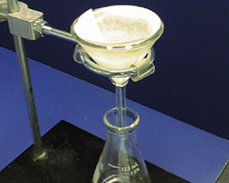

Precipitate of PbSO4
Separation of Pb²⁺ and Zn²⁺ solution
20 mL of distilled water is added and heated up to 60 °C.
10% K₂SO₄ solution is added dropwise until completion of precipitation
Solution is digested for about 10 min
A drop of K₂SO₄ was added to check for completion of precipitation
Solution is filtered using whatmann filter paper
Zn2+ solution
Estimation of Zn²⁺ solution
Solution in burette: standardized EDTA
10 mL filtrate + 5 mL of NH₄OH-NH4Cl buffer
On adding a few drops EBT indicator, Zn-EBT complex (wine-red) is formed
At end point, EDTA replaces EBT from Zn-EBT complex giving blue colour
15

Slide 17



Estimation of Pb²⁺ in given solution
Precipitate of PbSO₄ is dissolved using CH₃COONH₄ & CH₃COOH
Solution is made up to mark of 100 mL
Solution in burette: standardized EDTA solution
10 mL of Pb²⁺ sol. + hexamine buffer
On adding a few drops of XO indicator, Pb-XO complex (violet-red) is formed
EDTA replaces XO from Pb-XO complex➔ free XO (lemon-yellow) is obtained
16

Slide 18
Calculations
Let normality of std ZnO solution prepared be N_{ZnO}.
Normality of given EDTA solution: Zn-EBT (wine red) + EDTA ➔ Zn-EDTA + EBT (blue)
N_{EDTA} × V_{EDTA} = N_{ZnO} × V_{ZnO}
N_{EDTA} = (N_{ZnO} × 10) / V_{EDTA} (V_{EDTA} obtained form step 2)
Normality of Zn²⁺ in given solution: Zn-EBT (wine red) + EDTA ➔ Zn-EDTA + EBT (blue)
N_{EDTA} × V_{EDTA} = N_{Zn2+} × V_{Zn2+}
N_{Zn2+} = (N_{EDTA} × V_{EDTA} ) / 10 (V_{EDTA} obtained form step 3)
Normality of Pb²⁺ in given solution: Pb-XO (violet red) + EDTA ➔ Pb-EDTA + XO (yellow)
N_{EDTA} × V_{EDTA} = N_{Pb2+} × V_{Pb2+}
N_{Pb2+} = (N_{EDTA} × V_{EDTA} )/ 10 (V_{EDTA} obtained form step 4)
17

Slide 19
Applications
Analysis of various lead-containing alloys such as bronzes, ounce metal, solders and tin- and lead-based alloys
Analysis of content in zinc-lead ore
Analysis of glass certified reference material– optical glasses etc.
Removal of zinc and lead contamination from water, sewage and soil by estimating them
OF TODAY’S EXPERIMENT
18

Slide 20
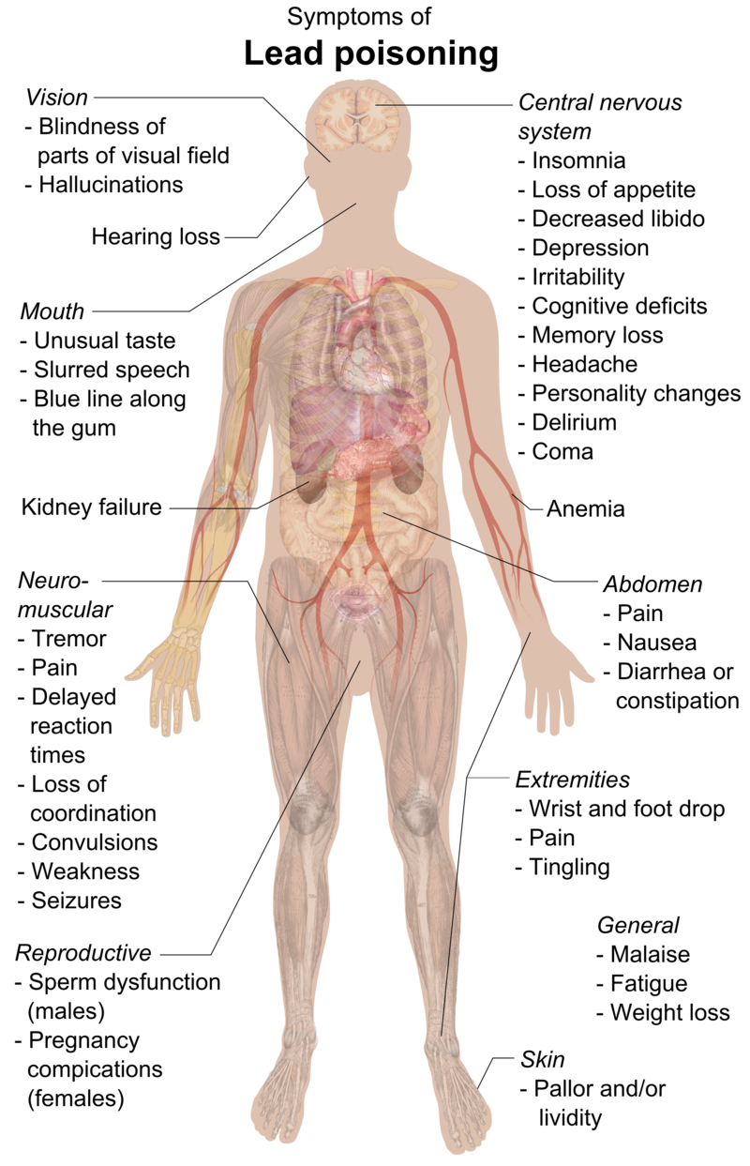
Precautions
Lead is a highly poisonous metal (whether inhaled or swallowed), affecting almost every organ and system in the human body. Hence masks and gloves are must while handling solution containing Pb²⁺ ions.
Cu, Co, Ni, Cr, Fe, Al even in traces must be absent as they interfere in the titration by forming more stable M-EDTA complexes.
Deionized water is preferred over distilled water.
PbSO₄ ppt must be washed properly so as to make sure removal of Zn²⁺ solution from it.
Burette must be rinsed with EDTA solution before titrations.
19

Slide 21
References
Vogel’s textbook of quantitative chemical analysis
Quantitative chemical analysis by Daniel C. Harris
https://en.wikipedia.org/wiki/Lead(II)_acetate
https://chemistry.stackexchange.com/
https://www.chemeurope.com/en/encyclopedia/
20

